Slide 1
Tariffs and Their Effects
Alan V. Deardorff
University of Michigan
Presentation to Economic Dinner Group
November 18, 2024

Slide 2
Outline
US Tariff History
Trump I Tariffs
Trump II Tariff Proposals
Tariff Effects in General
Effects of Trump II Tariffs

Slide 3
US Tariff History

Slide 4
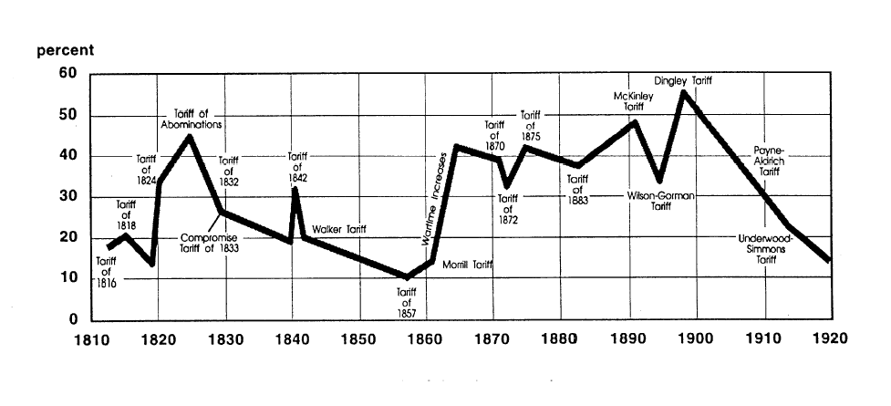
US Tariff History, 1810-1920
Today, pre-Trump
Notes:
Source: Don’t know

Slide 5
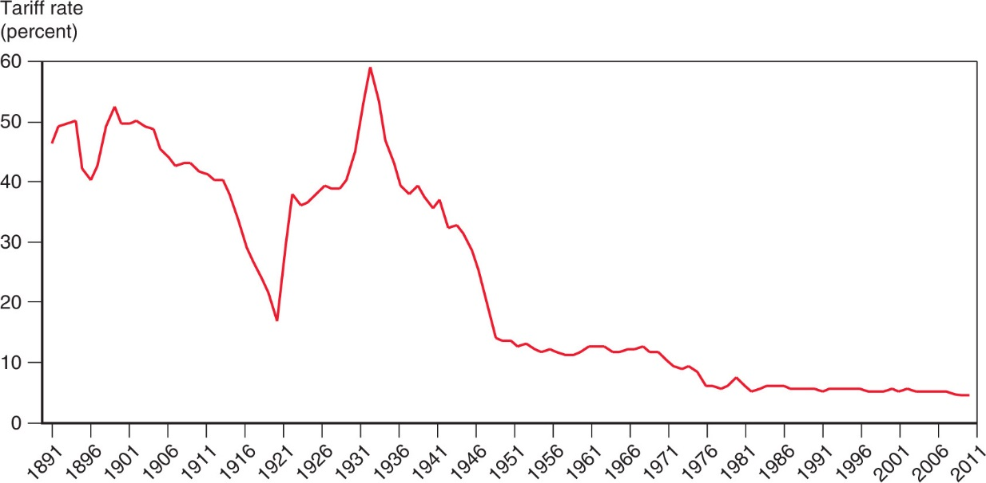
US Tariff History, 1891-2011
Smoot-Hawley Tariff
1934 Reciprocal Trade Agreements Act
1947 GATT
1995 WTO

Slide 6
Trump I Tariffs and the Trade War

Slide 7
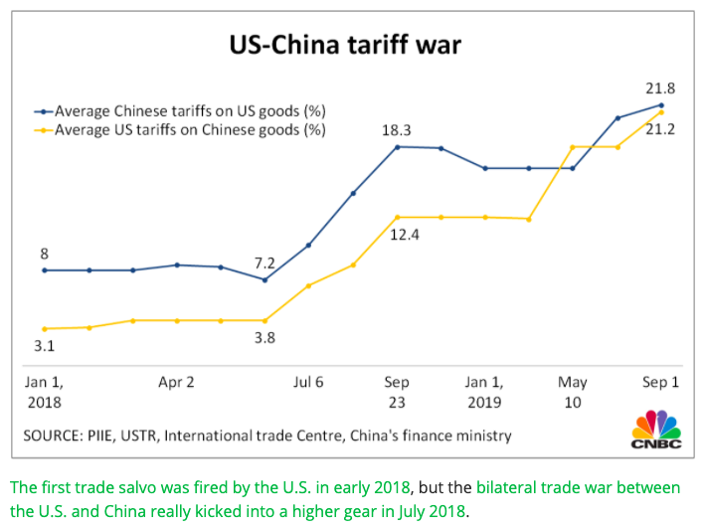
US-China Tariff War – Tariff Rates
Source: CNBC.com
Notes:
SEPTEMBER 18, 2019 | Yen Nee Lee, CNBC.com
http://nbr.com/2019/09/18/these-4-charts-show-how-us-china-trade-has-changed-during-the-tariff-dispute/

Slide 8
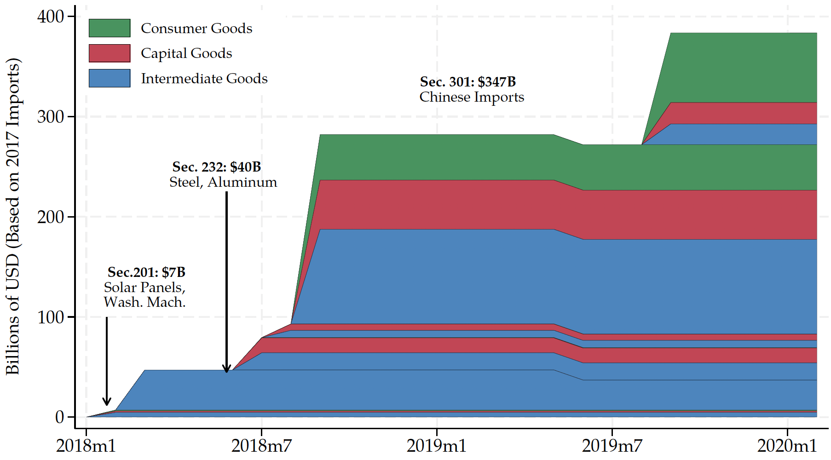
Trump I Tariffs - US Imports Covered
US imports from China in 2017, per World Bank:
$480 billion
Source: Flaaen & Pierce 2020
Notes:
SEPTEMBER 18, 2019 | Yen Nee Lee, CNBC.com
http://nbr.com/2019/09/18/these-4-charts-show-how-us-china-trade-has-changed-during-the-tariff-dispute/

Slide 9
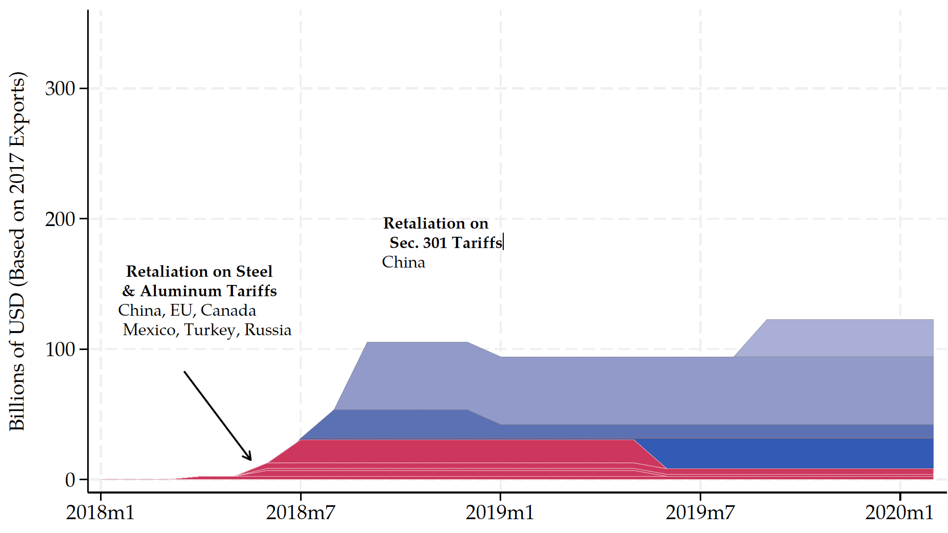
Trump I Tariff Retaliation - US Exports Covered
US exports to China in 2017, per World Bank:
$154 billion
Source: Flaaen & Pierce 2020
Notes:
SEPTEMBER 18, 2019 | Yen Nee Lee, CNBC.com
http://nbr.com/2019/09/18/these-4-charts-show-how-us-china-trade-has-changed-during-the-tariff-dispute/

Slide 10
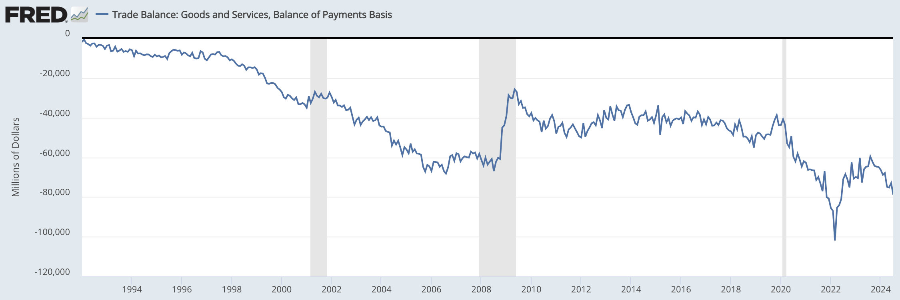
US Trade Balance = Exports minus Imports
Clinton
Bush
Obama
Trump
Biden
Note the zero. This whole thing is negative – a trade deficit! – and getting mostly larger since 1992.
Recessions
Notes:
FRED,
https://fred.stlouisfed.org/series/BOPGSTB
Sep 30, 2024

Slide 11
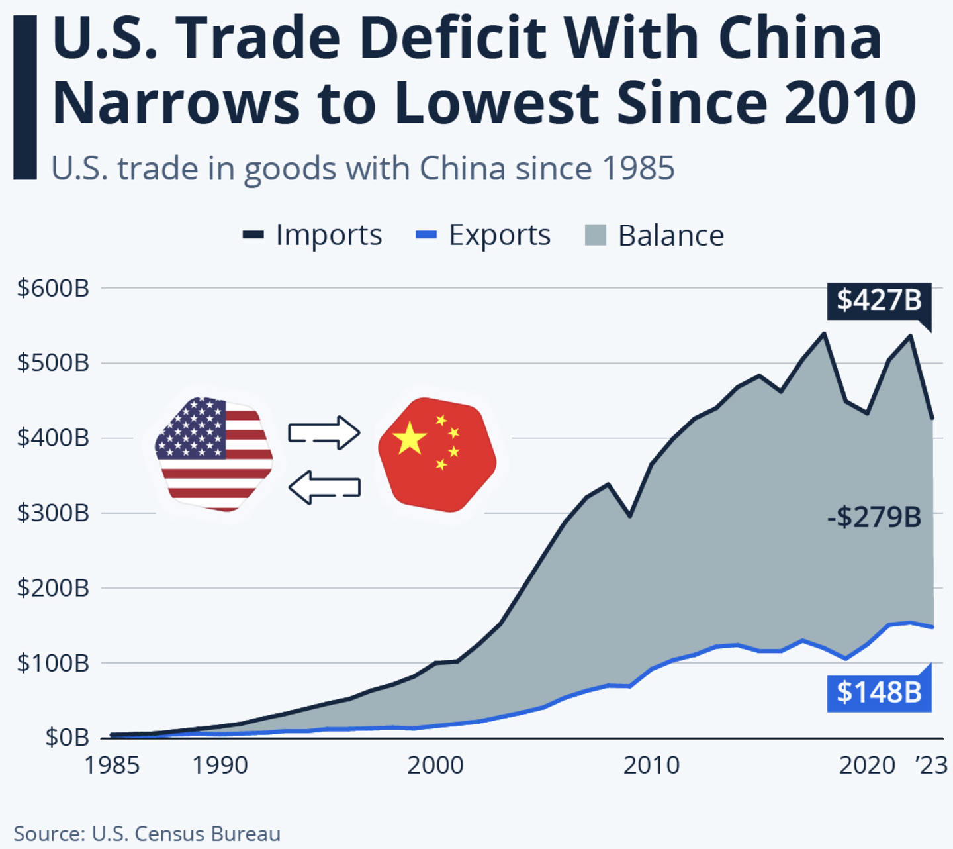
US Trade Balance with China
Notes:
Richter, “Is the U.S. Pulling Away From China Economically?” statista, 11/4/24
https://www.statista.com/chart/17982/us-trade-in-goods-with-china-since-1985/

Slide 12
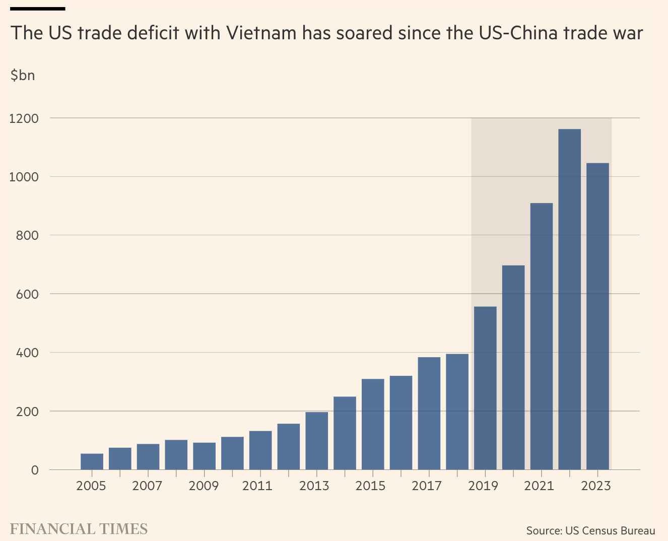
US Trade Balance with Vietnam
Notes:
Lakshmi, “Why Vietnam risks ending up a big loser from Trump’s tariffs,” FT, 11/17/24
https://www.ft.com/content/4f9f11dd-2278-49a6-9e70-b87916667fbe

Slide 13

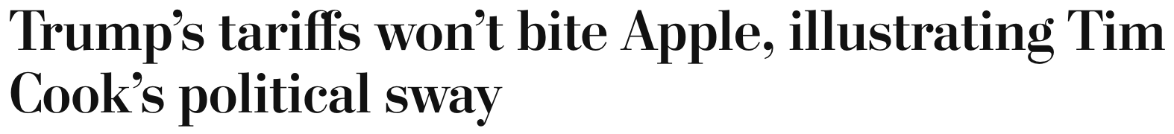
Trump Tariff Exemptions
September 18, 2018:
“Clearly Tim Cook has been effective in his developing a relationship with the current administration, and this is probably one of the best examples of the fruits of that labor.”

Slide 14
Trump Tariff Exemptions
Both the metals tariffs and the China tariffs permitted certain products and product categories to be exempted, through an application process to Commerce (metals) and USTR (China), if certain criteria are satisfied.
Whether tariffs would impose significant harm on American business interests
Whether substitute products were available outside China
Whether the products were “strategically important” to China”

Slide 15
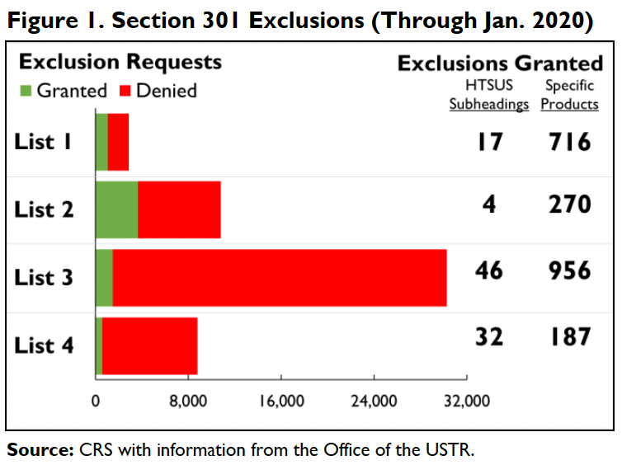
Trump Tariff Exemptions
Notes:
Andres B. Schwarzenberg, “Section 301 Tariff Exclusions on U.S. Imports from China,” Congressional ioal Research Service, May 13, 2024
https://crsreports.congress.gov/product/pdf/IF/IF11582

Slide 16
Trump Tariff Exemptions
Issues with the exemptions
“Firms hiring lobbyists were less likely to have steel tariff exemptions approved.”
Contributions to Republicans made China exemptions more likely
Contributions to Democrats made China exemptions less likely
Renewal of exemptions were uncertain and came late enough to create uncertainty.
Notes:
Keynes, Soumaya, “Your guide to how to dodge a tariff,” FT, 11/15/24
https://www.ft.com/content/f9e4cc47-5b70-4beb-85df-a49a9f03181c
Armstrong, Dan, “Politically Connected Corporations Received More Exemptions from U.S. Tariffs on Chinese Imports, Study Finds,” Lehigh News, October 8,, 2024
https://www2.lehigh.edu/news/politically-connected-corporations-received-more-exemptions-from-us-tariffs-on-chinese-imports
Ben Unglesbee, “Biden administration extends China tariff exclusions — again,” SupplyChainDive, January 4, 2024.
https://www.supplychaindive.com/news/biden-administration-extends-china-tariff-exclusions-May-2024/703510/

Slide 17
Trump II Tariffs

Slide 18
Trump II Tariff Plans
“To me the most beautiful word in the dictionary is ‘tariff’”
Has said he will
Place a tariff of 10% or 20% on all imports from all countries.
Place even higher tariffs (60%) on imports from China.
Raise our tariffs on countries to match what they charge on our exports.
“Reciprocal Trade Act”
(And lower those where they charge less?)
Raise tariffs on countries that don’t use the US dollar for international transactions.
Place tariffs on Mexico, violating his own USMCA trade agreement
25% on everything if they don’t stop US immigration
100% on cars to get production in US
Notes:
McCormick, “Trump Calls Tariffs the ‘Most Beautiful Word’,” WSJ, 10/14/24
https://www.wsj.com/livecoverage/harris-trump-election-10-16-2024/card/trump-calls-tariffs-the-most-beautiful-word--YMVPAupw4EjBRp6yobOy
Swanson, “Harris and Trump Embrace Tariffs, Though Their Approaches Differ,” New York Times, Aug 27, 2024.
https://www.nytimes.com/2024/08/27/us/politics/trump-harris-tariffs.html
Toomey, “About Trump’s ‘Reciprocal’ Tariffs,” WSJ, 10/27/24
https://www.wsj.com/opinion/about-trumps-reciprocal-tariffs-he-wants-to-raise-taxes-and-thinks-im-the-stupid-one-5dc3c56c?mod=itp_wsj
Krugman, “Donald Trump on the Dollar, in His Own Words. NYT, 9/9/24
https://www.nytimes.com/2024/09/09/opinion/trump-tariffs-reserve-currency.html
Economist, “Donald Trump is poised to smash Mexico with tariffs,” 11/7/24
https://www.economist.com/the-americas/2024/11/07/donald-trump-is-poised-to-smash-mexico-with-tariffs
Ewing, “Trump’s Tariffs Could Deal a Blow to Mexico’s Car Factories,” NYT, 11/12/24
https://www.nytimes.com/2024/11/12/business/economy/trump-mexico-trade-tariffs-car-factories.html

Slide 19
Trump II Tariff Plans
What will Trump actually do?
Beattie in FT 11/18/24: “trade policy in his first administration emerged from fierce internal battles like a victorious but bloodied rat crawling out of a sack of rodent corpses, with Trump’s caprice determining which idea survived.”
He will surely do some of the things on this list
But not on everybody. He’ll use the threat to negotiate ”deals”
For the benefit of the country (?)
For the benefit of himself (!)
Notes:
McCormick, “Trump Calls Tariffs the ‘Most Beautiful Word’,” WSJ, 10/14/24
https://www.wsj.com/livecoverage/harris-trump-election-10-16-2024/card/trump-calls-tariffs-the-most-beautiful-word--YMVPAupw4EjBRp6yobOy
Swanson, “Harris and Trump Embrace Tariffs, Though Their Approaches Differ,” New York Times, Aug 27, 2024.
https://www.nytimes.com/2024/08/27/us/politics/trump-harris-tariffs.html
Toomey, “About Trump’s ‘Reciprocal’ Tariffs,” WSJ, 10/27/24
https://www.wsj.com/opinion/about-trumps-reciprocal-tariffs-he-wants-to-raise-taxes-and-thinks-im-the-stupid-one-5dc3c56c?mod=itp_wsj
Krugman, “Donald Trump on the Dollar, in His Own Words. NYT, 9/9/24
https://www.nytimes.com/2024/09/09/opinion/trump-tariffs-reserve-currency.html
Economist, “Donald Trump is poised to smash Mexico with tariffs,” 11/7/24
https://www.economist.com/the-americas/2024/11/07/donald-trump-is-poised-to-smash-mexico-with-tariffs
Ewing, “Trump’s Tariffs Could Deal a Blow to Mexico’s Car Factories,” NYT, 11/12/24
https://www.nytimes.com/2024/11/12/business/economy/trump-mexico-trade-tariffs-car-factories.html
Beattie, “Where Trump will go with his plans on trade,” FT, 11/18/24
https://www.ft.com/content/afab0fab-524b-4845-addd-bcffbe6b0b22

Slide 20
Trump II Tariff Plans
What will Trump be able do?
The constitution gives power over tariffs only to Congress, not the President
But Congress has passed laws delegating that power to the President In certain circumstances:
Section 201 of 1974 Trade Act: Safeguards, used for washing machines
Section 232 of 1962 Trade Act: National security, used for steel
Section 301 of 1974 Trade Act: Unfair trade, used for China tariffs
International Emergency Economic Powers Act of 1977, not used yet
For his tariffs on all imports, he may need to get Congress to act, but Beatie in FT disagrees
Reciprocal Trade Act would have to be by Congress
Notes:
McCormick, “Trump Calls Tariffs the ‘Most Beautiful Word’,” WSJ, 10/14/24
https://www.wsj.com/livecoverage/harris-trump-election-10-16-2024/card/trump-calls-tariffs-the-most-beautiful-word--YMVPAupw4EjBRp6yobOy
Swanson, “Harris and Trump Embrace Tariffs, Though Their Approaches Differ,” New York Times, Aug 27, 2024.
https://www.nytimes.com/2024/08/27/us/politics/trump-harris-tariffs.html
Toomey, “About Trump’s ‘Reciprocal’ Tariffs,” WSJ, 10/27/24
https://www.wsj.com/opinion/about-trumps-reciprocal-tariffs-he-wants-to-raise-taxes-and-thinks-im-the-stupid-one-5dc3c56c?mod=itp_wsj
Krugman, “Donald Trump on the Dollar, in His Own Words. NYT, 9/9/24
https://www.nytimes.com/2024/09/09/opinion/trump-tariffs-reserve-currency.html
Economist, “Donald Trump is poised to smash Mexico with tariffs,” 11/7/24
https://www.economist.com/the-americas/2024/11/07/donald-trump-is-poised-to-smash-mexico-with-tariffs
Ewing, “Trump’s Tariffs Could Deal a Blow to Mexico’s Car Factories,” NYT, 11/12/24
https://www.nytimes.com/2024/11/12/business/economy/trump-mexico-trade-tariffs-car-factories.html
Beattie, “Where Trump will go with his plans on trade,” FT, 11/18/24
https://www.ft.com/content/afab0fab-524b-4845-addd-bcffbe6b0b22

Slide 21
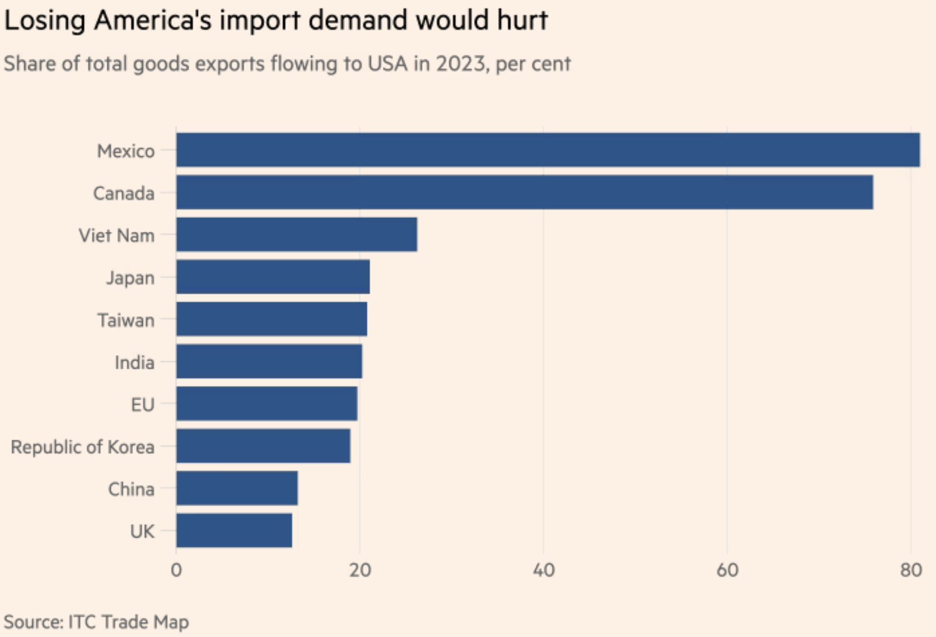
What Countries will Be Hurt?
Source:
Keynes, FT, 11/15/24
Notes:
Keynes, Soumaya, “Your guide to how to dodge a tariff,” FT, 11/15/24
https://www.ft.com/content/f9e4cc47-5b70-4beb-85df-a49a9f03181c

Slide 22
Effects of Tariffs in General

Slide 23
Economic effects of a tariff
A tariff is a tax on imports. It causes
A rise in the price of the imported good in the importing country
A fall in the price of the imported good in the exporting country
The quantity imported to fall
Revenue for the tariff-levying government
Almost always: the rise at home is much larger than the fall abroad
That’s especially true if importing country is small
But it’s also true if importing country is as large as the U.S.
Example: Trump’s tariffs caused US prices to rise, with hardly any perceptible fall in prices abroad.

Slide 24
Effects of a tariff
The rise in price in the importing country causes
A rise in price of competing goods produced there
Benefits to those producers
Harm to buyers of both the import and the competing goods
Including producers that use the higher-priced goods as inputs
Their prices also rise, hurting their buyers
Employment changes:
Increase in the protected industry
Decrease in industries that use the protected product as inputs
Example: Trump’s 25% tariff on steel
Helped US steel firms and their workers
Hurt US auto firms and workers
and many other industries that use steel

Slide 25
Effects of a tariff
If a tariff is on exports of only one country (e.g., China), then
Some imports shift to another country
Price rises by less, to that other country’s higher cost
Example: See next slide for Christmas Lights

Slide 26
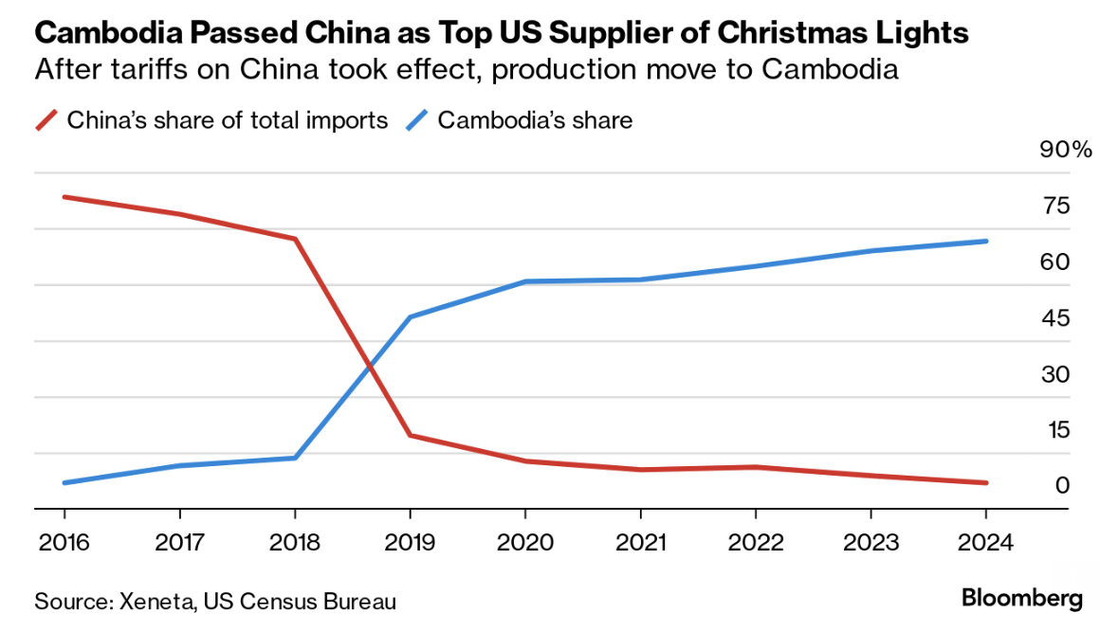
Effects of Trump I on Christmas Lights
A few key things are unclear in the case of Christmas lights that Xeneta analyzed, like whether the production actually moved from China or whether the goods were merely diverted and then packaged in Cambodia by Chinese affiliates.
Notes:
Bloomberg Supply Lines, 11/14/24
https://mail.google.com/mail/u/0/?shva=1#inbox/FMfcgzQXKDfRqwmLlHHMJDDlWNpqbKTq

Slide 27
Effects of a tariff
Do tariffs reduce a trade deficit?
Trump thinks so, but the US deficit grew under him (see above)
A trade deficit equals Expenditure minus Income
There is no reason for tariffs to reduce expenditure
And unless in a recession, no reason for tariffs to raise income
So NO!

Slide 28
Effects of a tariff
Government revenue
Could Trump’s proposed tariffs replace the US income tax?
NO!
If imports did not fall (they would!), his tariffs would have collected in 2023:
60% on US goods imports from China, 0.6✕$0.43tr = $0.26tr
20% on US goods imports from non-China, 0.2✕$3.40tr = $0.68tr
Total: $0.94tr
US federal income tax revenue in 2023 was $2.18tr
So his tariffs would collect AT MOST less than half of the income tax

Slide 29
Other effects of a tariff
Income distribution
Tariffs, especially on China, raise prices of the products disproportionately bought by low-income consumers, hurting them more than high-income consumers
Retaliation
Other countries place tariffs on US exports
Trade war that started in 2018 continues and gets worse
Corruption
Historically, tariffs prompted both smuggling and bribes to customs officers
Today, in the US, those are less likely.
But requests for exemptions from tariffs may be accompanied by favors or political contributions

Slide 30
Effects of Trump II Tariffs

Slide 31
Effects of Trump II Tariffs
Source: Warwick McKibbin, Megan Hogan, and Marcus Noland, “The International Economic Implications of a Second Trump Presidency,” Working Paper 24-20, Peterson Institute of International Econnomics, September 2024
They use a large computer model of both microeconomics and macroeconomics to calculate effects of
Deportation of 8.3 million unauthorized immigrant workers
Tariffs
10% on all imports
60% on imports from China
Erosion of Federal Reserve independence
Results below for the 2 sets of tariffs
Notes:
Warwick McKibbin, Megan Hogan, and Marcus Noland, “The International Economic Implications of a Second Trump Presidency,” Working Paper 24-20, Peterson Institute of International Econnomics, September 2024.
https://www.piie.com/publications/working-papers/2024/international-economic-implications-second-trump-presidency

Slide 32
Effects of Trump Proposed Tariffs
on GDP

Slide 33
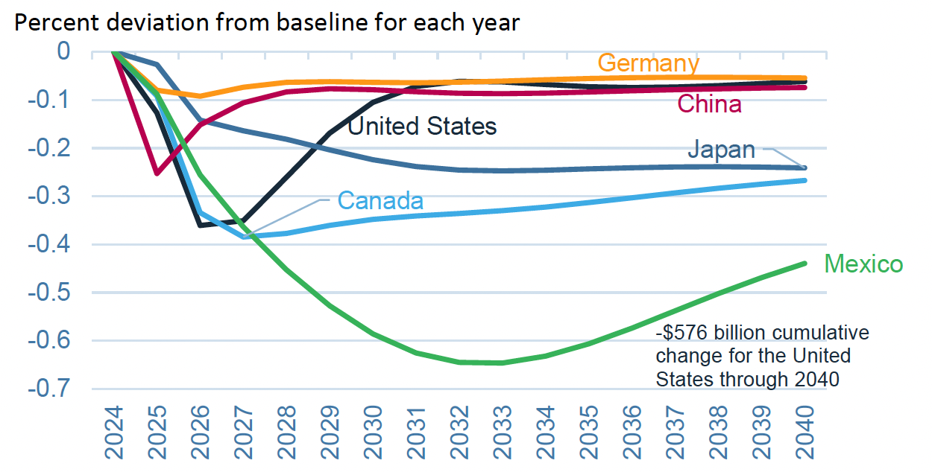
Effects of 10% Tariff on All US Imports
Real GDP
Notes:
Warwick McKibbin, Megan Hogan, and Marcus Noland, “The International Economic Implications of a Second Trump Presidency,” Working Paper 24-20, Peterson Institute of International Econnomics, September 2024.
https://www.piie.com/publications/working-papers/2024/international-economic-implications-second-trump-presidency

Slide 34
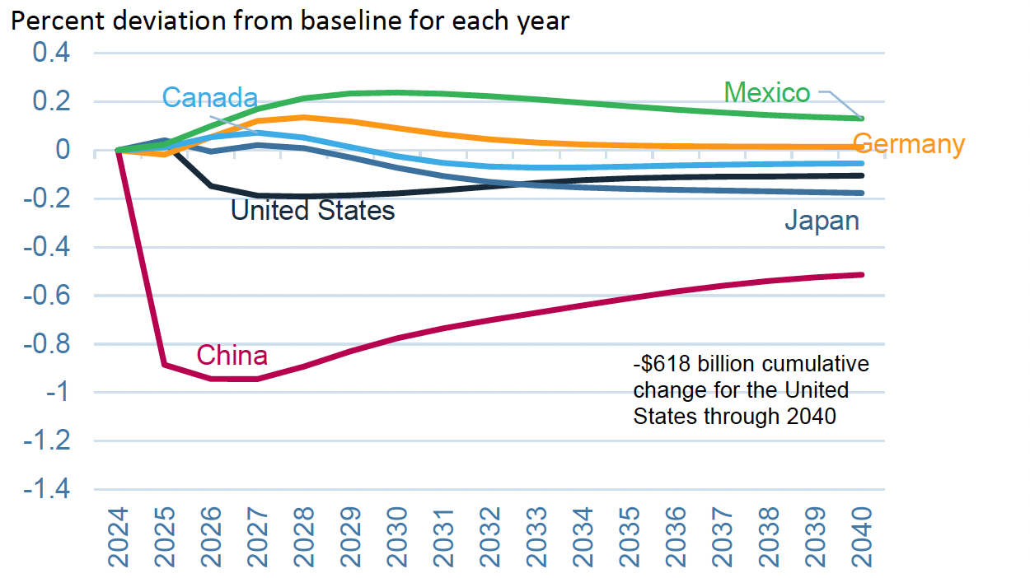
Effects of 60% Tariff on China Exports
Real GDP
Notes:
Warwick McKibbin, Megan Hogan, and Marcus Noland, “The International Economic Implications of a Second Trump Presidency,” Working Paper 24-20, Peterson Institute of International Econnomics, September 2024.
https://www.piie.com/publications/working-papers/2024/international-economic-implications-second-trump-presidency

Slide 35
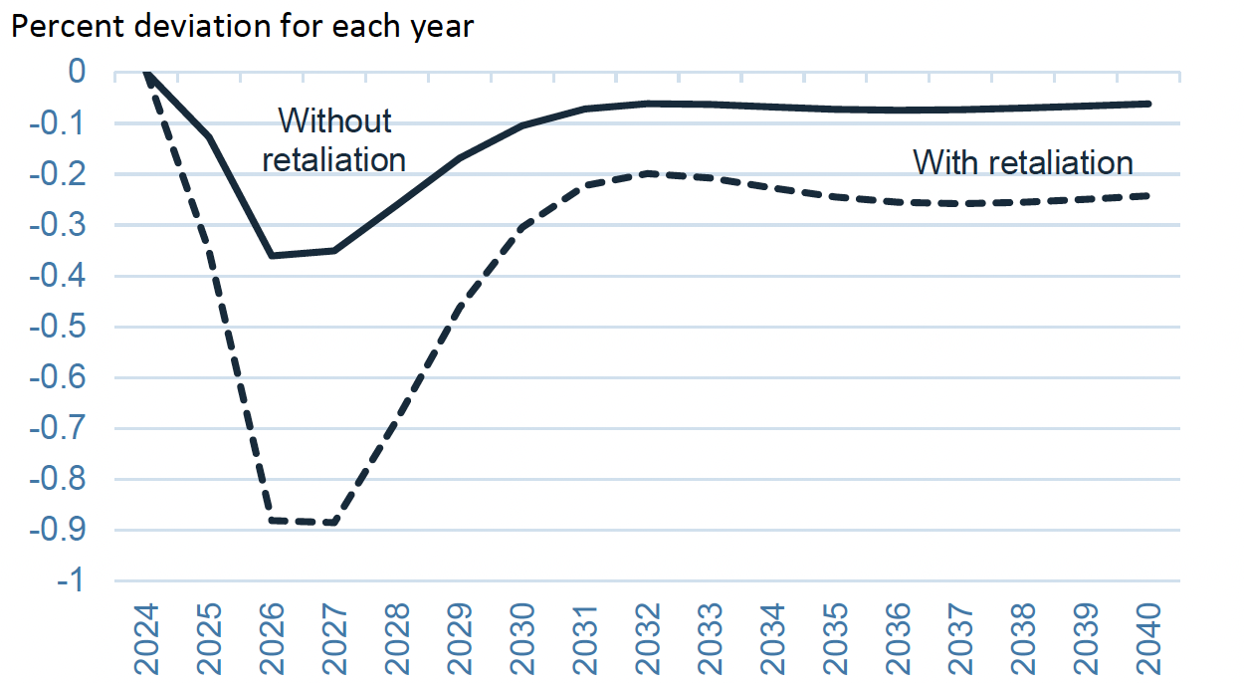
Effects of 10% Tariff on All US Imports
US GDP with and without Retaliation
Notes:
Warwick McKibbin, Megan Hogan, and Marcus Noland, “The International Economic Implications of a Second Trump Presidency,” Working Paper 24-20, Peterson Institute of International Econnomics, September 2024.
https://www.piie.com/publications/working-papers/2024/international-economic-implications-second-trump-presidency

Slide 36
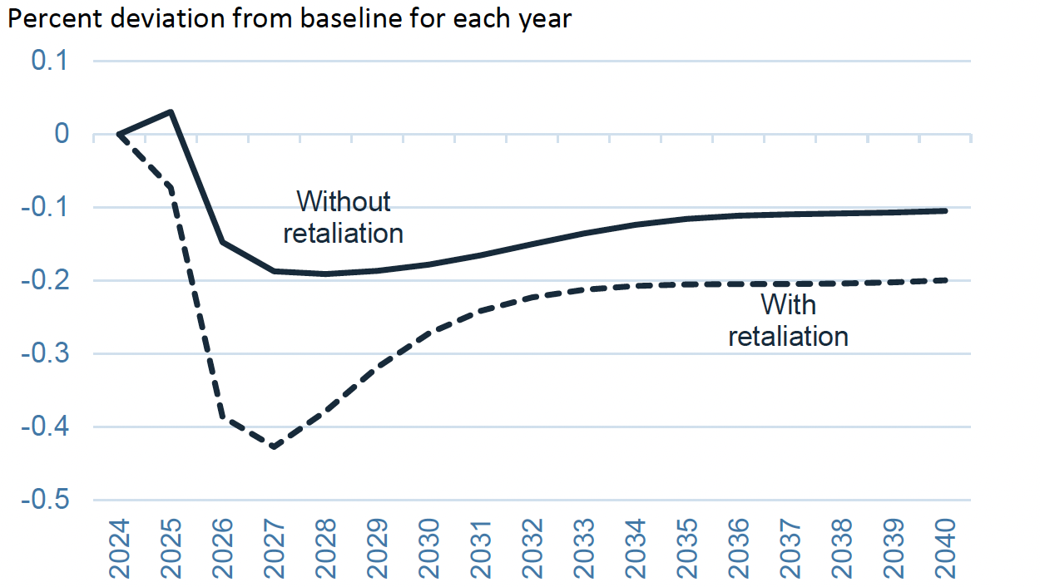
Effects of 60% Tariff on China Exports
US GDP with and without Retaliation
Notes:
Warwick McKibbin, Megan Hogan, and Marcus Noland, “The International Economic Implications of a Second Trump Presidency,” Working Paper 24-20, Peterson Institute of International Econnomics, September 2024.
https://www.piie.com/publications/working-papers/2024/international-economic-implications-second-trump-presidency

Slide 37
Effects of Trump Proposed Tariffs
on Employment

Slide 38
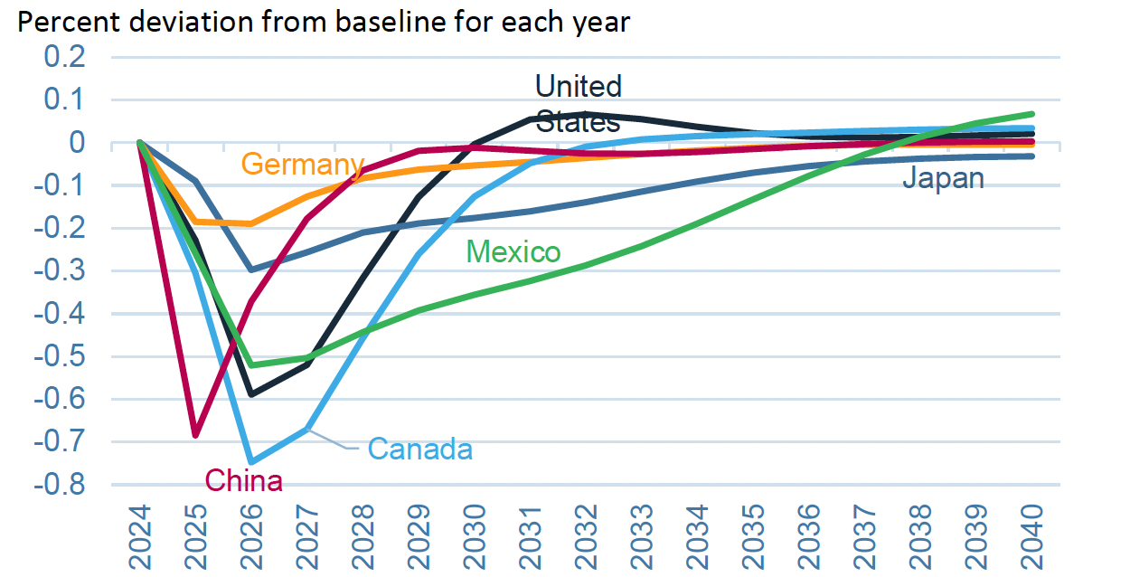
Effects of 10% Tariff on All US Imports
Employment
Notes:
Warwick McKibbin, Megan Hogan, and Marcus Noland, “The International Economic Implications of a Second Trump Presidency,” Working Paper 24-20, Peterson Institute of International Econnomics, September 2024.
https://www.piie.com/publications/working-papers/2024/international-economic-implications-second-trump-presidency

Slide 39
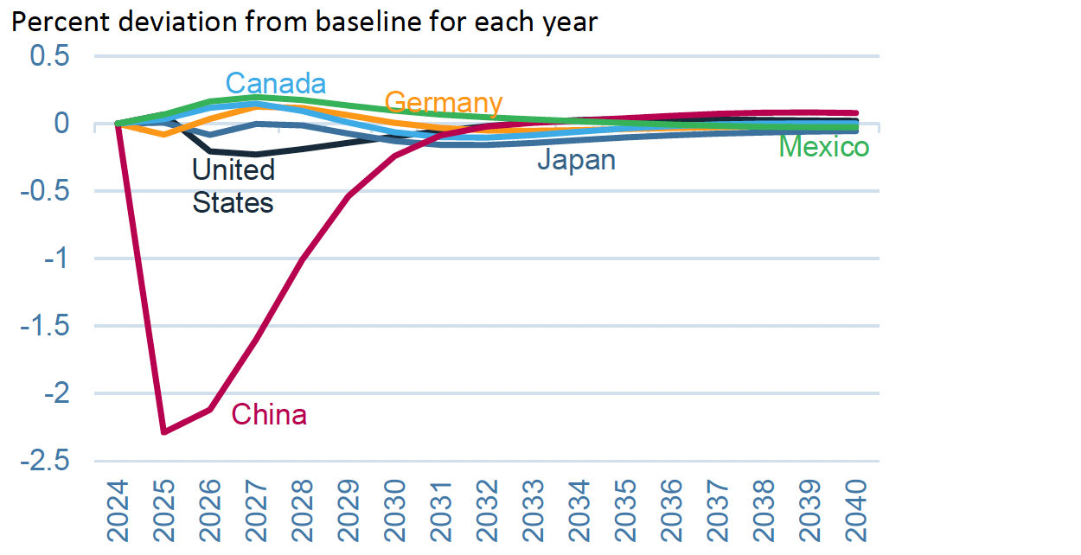
Effects of 60% Tariff on China Exports
Employment
Notes:
Warwick McKibbin, Megan Hogan, and Marcus Noland, “The International Economic Implications of a Second Trump Presidency,” Working Paper 24-20, Peterson Institute of International Econnomics, September 2024.
https://www.piie.com/publications/working-papers/2024/international-economic-implications-second-trump-presidency

Slide 40
Effects of Trump Proposed Tariffs
on Inflation

Slide 41
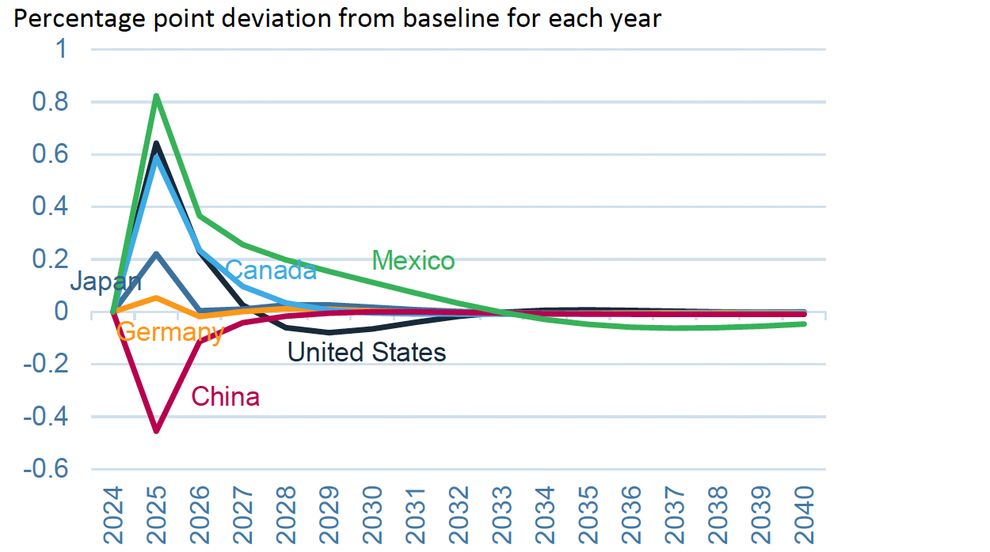
Effects of 10% Tariff on All US Imports
Inflation
Notes:
Warwick McKibbin, Megan Hogan, and Marcus Noland, “The International Economic Implications of a Second Trump Presidency,” Working Paper 24-20, Peterson Institute of International Econnomics, September 2024.
https://www.piie.com/publications/working-papers/2024/international-economic-implications-second-trump-presidency

Slide 42
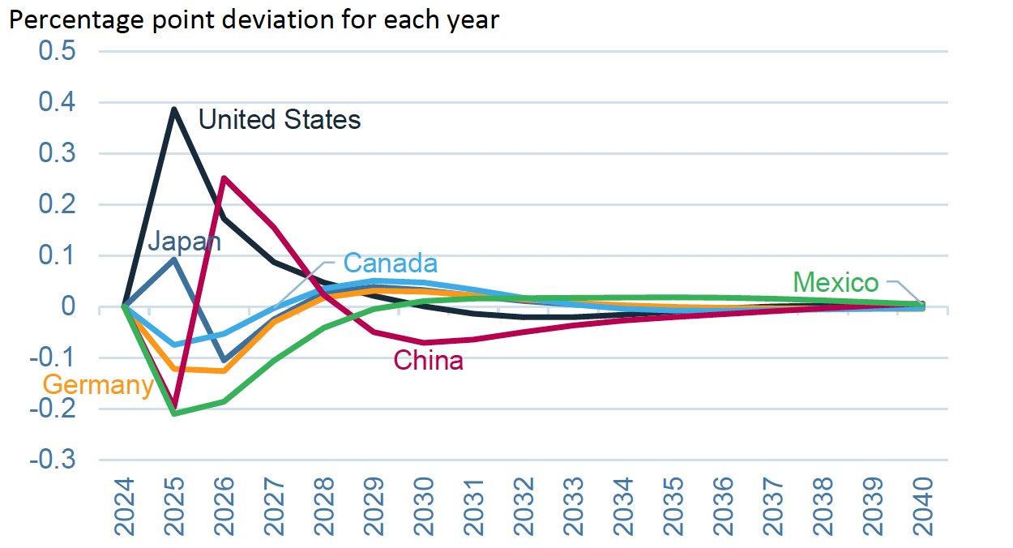
Effects of 60% Tariff on China Exports
Inflation
Notes:
Warwick McKibbin, Megan Hogan, and Marcus Noland, “The International Economic Implications of a Second Trump Presidency,” Working Paper 24-20, Peterson Institute of International Econnomics, September 2024.
https://www.piie.com/publications/working-papers/2024/international-economic-implications-second-trump-presidency

Slide 43
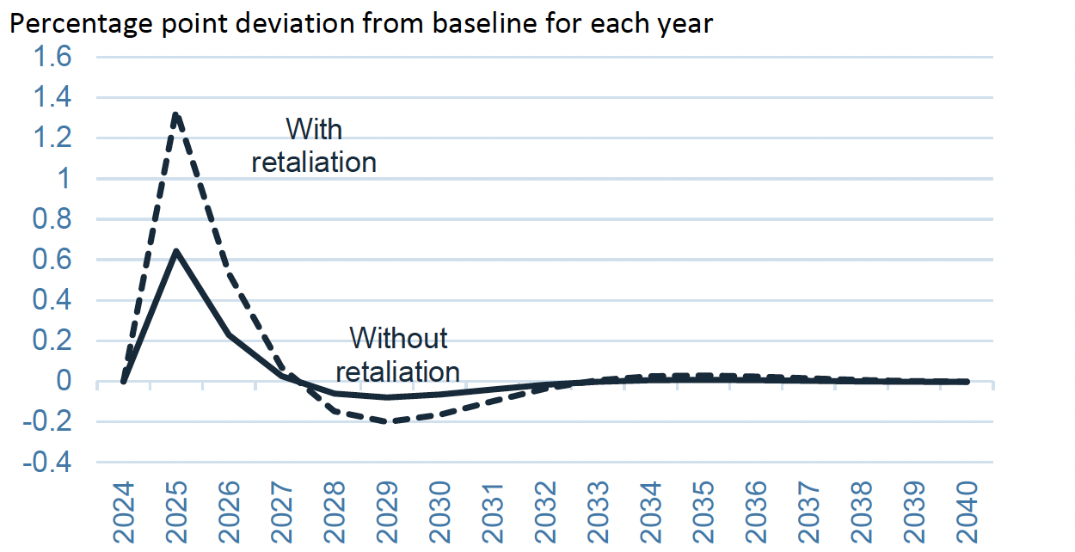
Effects of 10% Tariff on All US Imports
US Inflation with and without Retaliation
Notes:
Warwick McKibbin, Megan Hogan, and Marcus Noland, “The International Economic Implications of a Second Trump Presidency,” Working Paper 24-20, Peterson Institute of International Econnomics, September 2024.
https://www.piie.com/publications/working-papers/2024/international-economic-implications-second-trump-presidency

Slide 44
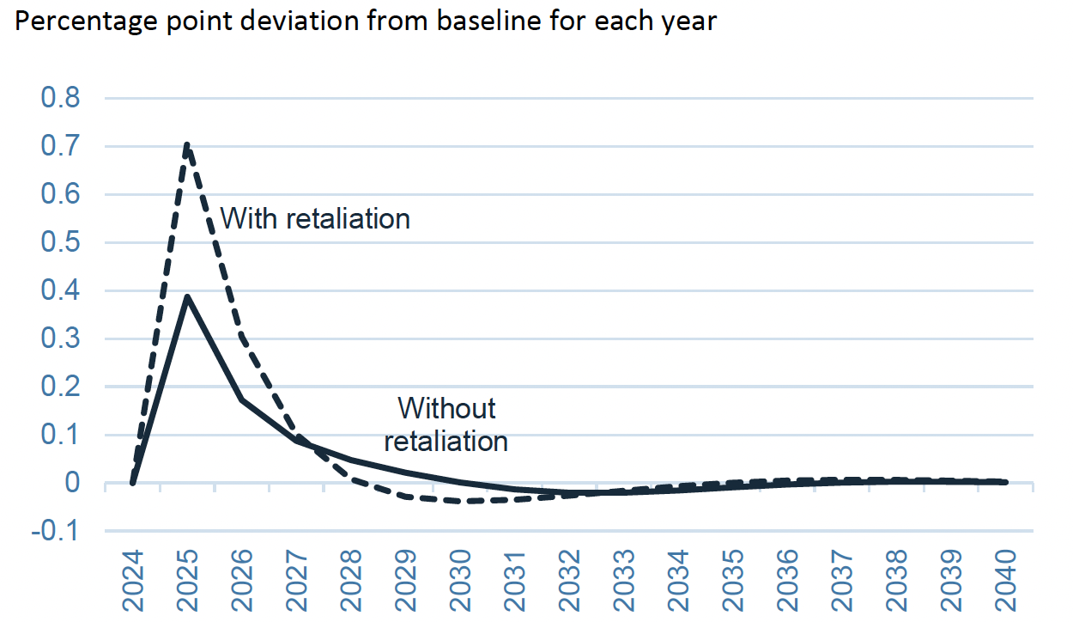
Effects of 60% Tariff on China Exports
US Inflation with and without Retaliation
Notes:
Warwick McKibbin, Megan Hogan, and Marcus Noland, “The International Economic Implications of a Second Trump Presidency,” Working Paper 24-20, Peterson Institute of International Econnomics, September 2024.
https://www.piie.com/publications/working-papers/2024/international-economic-implications-second-trump-presidency

Slide 45
Effects of Trump Proposed Tariffs
on Trade Surplus

Slide 46
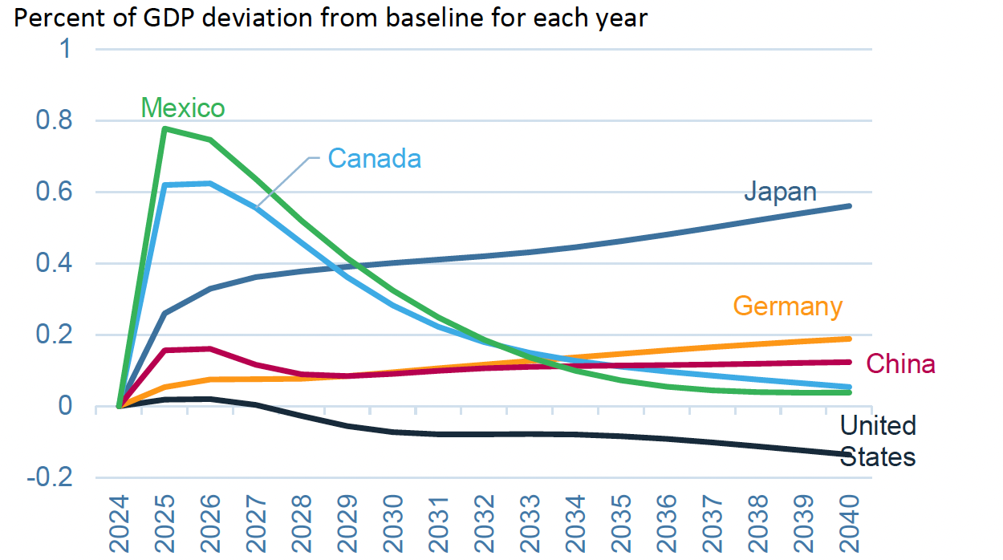
Effects of 10% Tariff on All US Imports
Trade Surplus
Notes:
Warwick McKibbin, Megan Hogan, and Marcus Noland, “The International Economic Implications of a Second Trump Presidency,” Working Paper 24-20, Peterson Institute of International Econnomics, September 2024.
https://www.piie.com/publications/working-papers/2024/international-economic-implications-second-trump-presidency

Slide 47
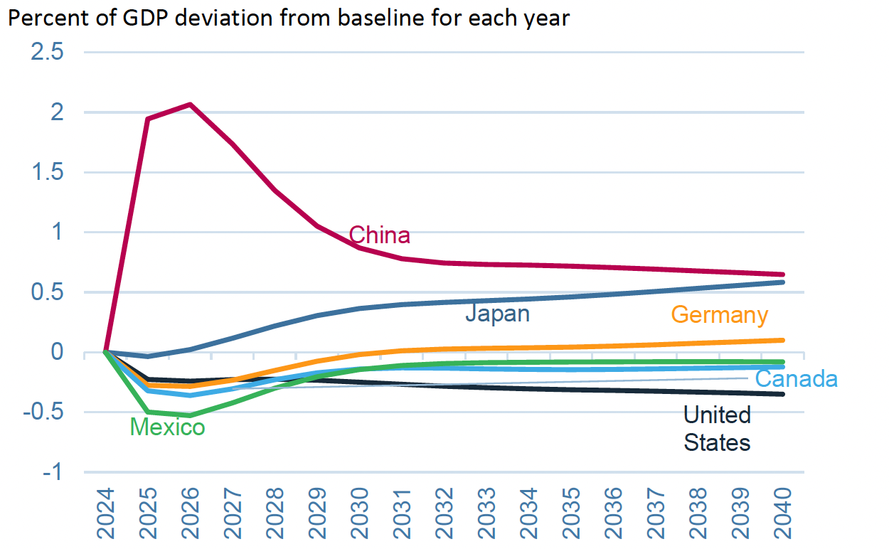
Effects of 60% Tariff on China Exports
Trade Surplus
Notes:
Warwick McKibbin, Megan Hogan, and Marcus Noland, “The International Economic Implications of a Second Trump Presidency,” Working Paper 24-20, Peterson Institute of International Econnomics, September 2024.
https://www.piie.com/publications/working-papers/2024/international-economic-implications-second-trump-presidency

Slide 48
Effects of Trump Proposed Tariffs
on Sectoral
Production

Slide 49
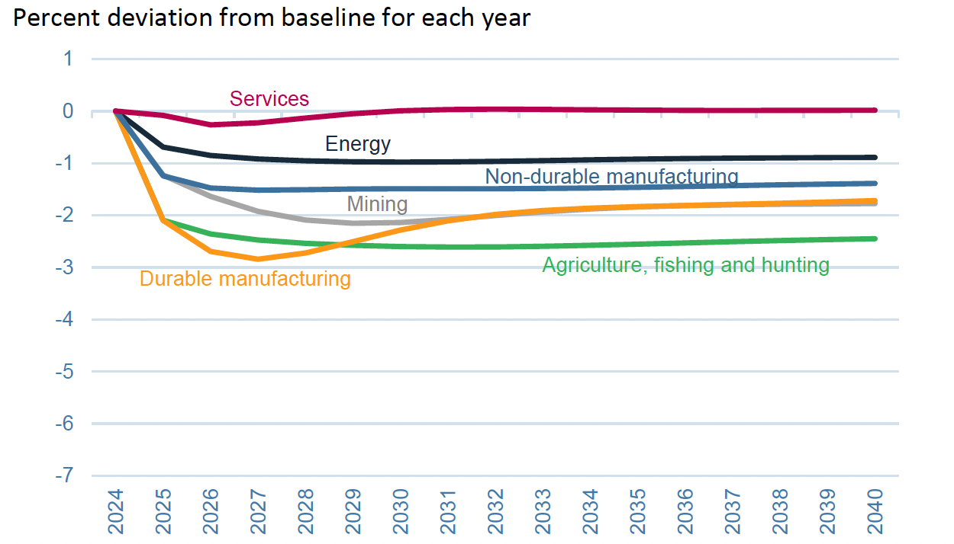
Effects of 10% Tariff on All US Imports
US Sectoral Production
Notes:
Warwick McKibbin, Megan Hogan, and Marcus Noland, “The International Economic Implications of a Second Trump Presidency,” Working Paper 24-20, Peterson Institute of International Econnomics, September 2024.
https://www.piie.com/publications/working-papers/2024/international-economic-implications-second-trump-presidency

Slide 50
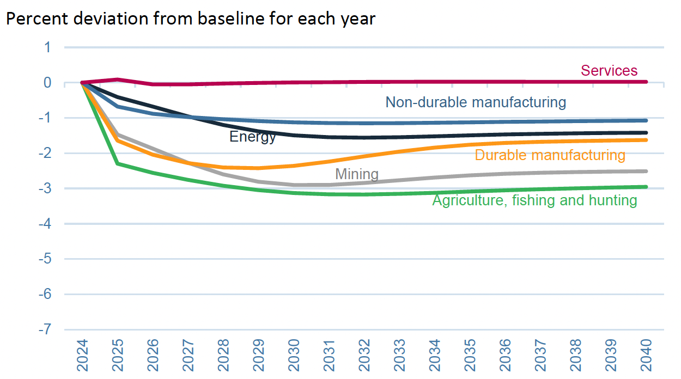
Effects of 60% Tariff on China Exports
US Sectoral Production
Notes:
Warwick McKibbin, Megan Hogan, and Marcus Noland, “The International Economic Implications of a Second Trump Presidency,” Working Paper 24-20, Peterson Institute of International Econnomics, September 2024.
https://www.piie.com/publications/working-papers/2024/international-economic-implications-second-trump-presidency

Slide 51
Effects of Trump Proposed Tariffs
on Sectoral
Employment

Slide 52
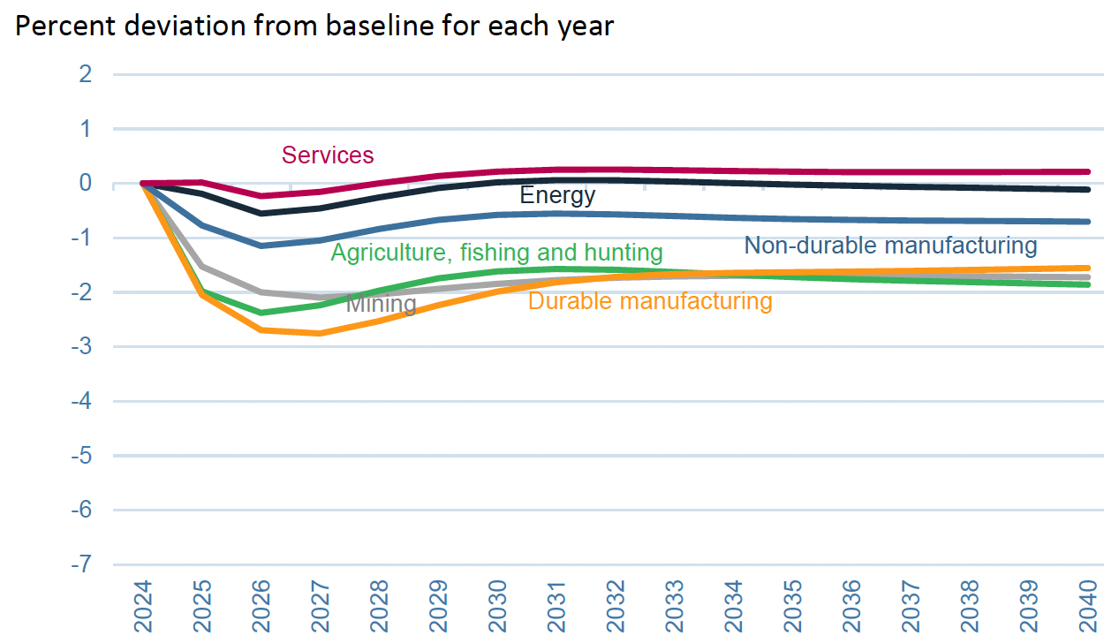
Effects of 10% Tariff on All US Imports
US Sectoral Employment
Notes:
Warwick McKibbin, Megan Hogan, and Marcus Noland, “The International Economic Implications of a Second Trump Presidency,” Working Paper 24-20, Peterson Institute of International Econnomics, September 2024.
https://www.piie.com/publications/working-papers/2024/international-economic-implications-second-trump-presidency

Slide 53
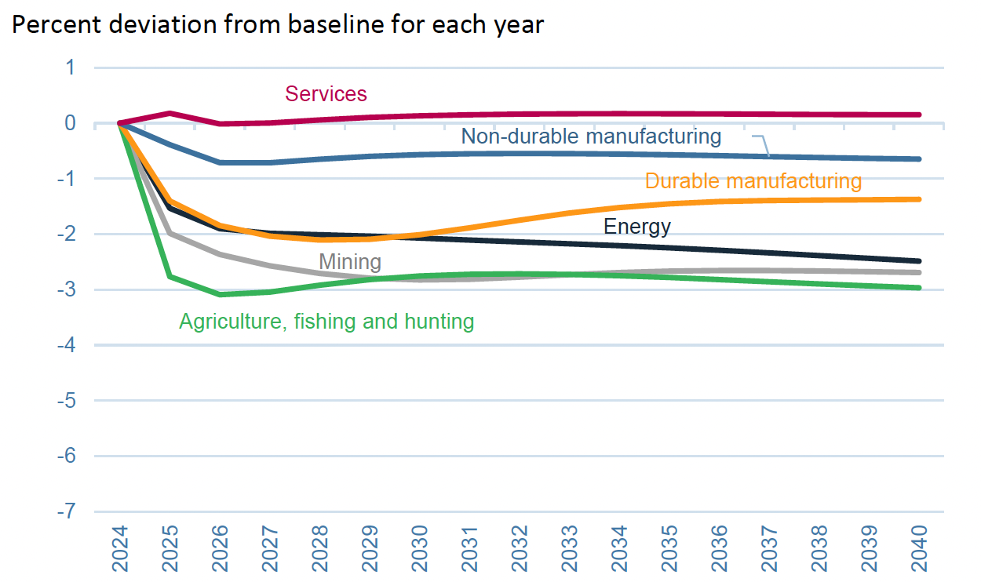
Effects of 60% Tariff on China Exports
US Sectoral Employment
Notes:
Warwick McKibbin, Megan Hogan, and Marcus Noland, “The International Economic Implications of a Second Trump Presidency,” Working Paper 24-20, Peterson Institute of International Econnomics, September 2024.
https://www.piie.com/publications/working-papers/2024/international-economic-implications-second-trump-presidency

Slide 54
Effects of Trump Proposed Tariffs
on Sectoral
Prices

Slide 55
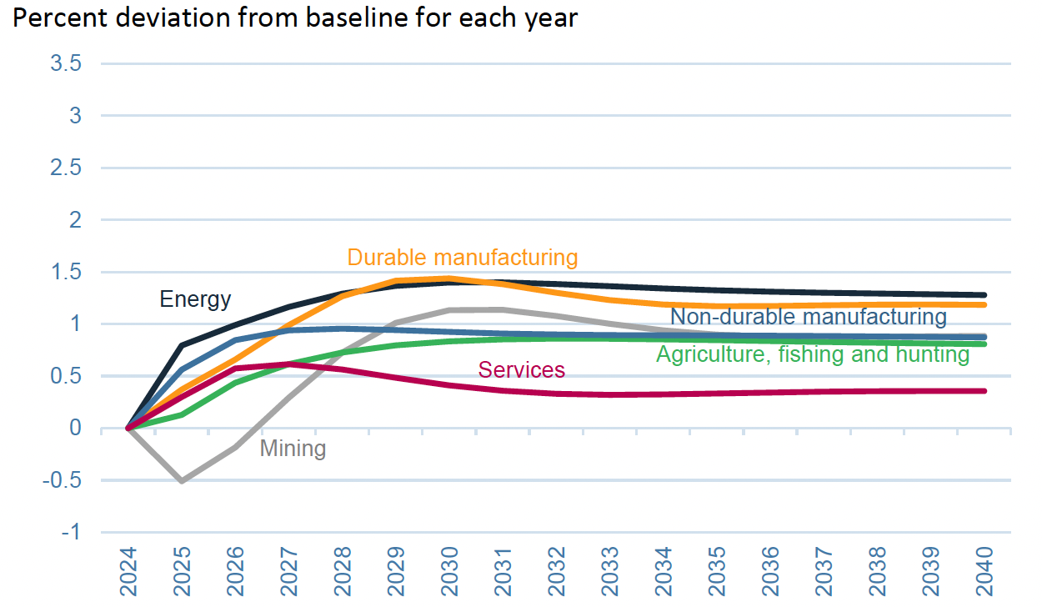
Effects of 10% Tariff on All US Imports
Sectoral Prices
Notes:
Warwick McKibbin, Megan Hogan, and Marcus Noland, “The International Economic Implications of a Second Trump Presidency,” Working Paper 24-20, Peterson Institute of International Econnomics, September 2024.
https://www.piie.com/publications/working-papers/2024/international-economic-implications-second-trump-presidency

Slide 56
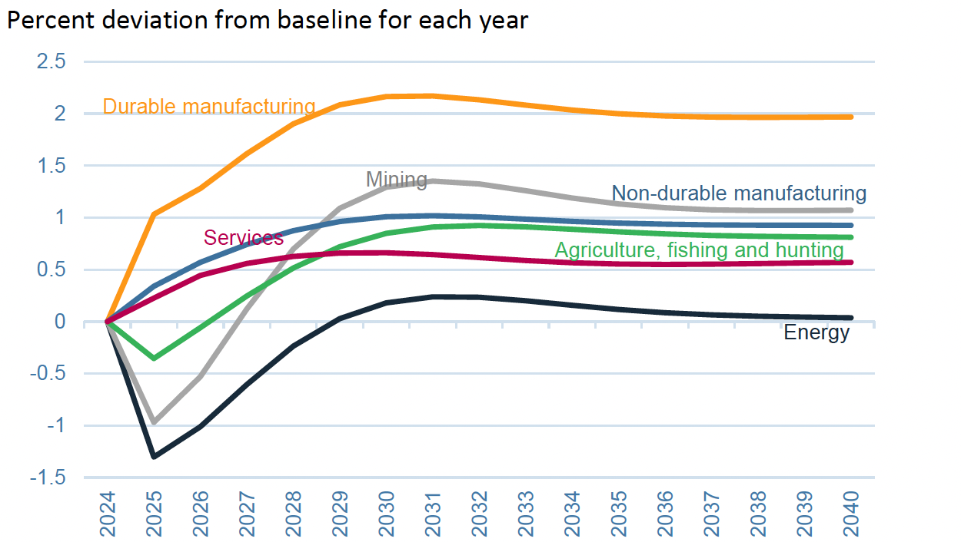
Effects of 60% Tariff on China Exports
US Sectoral Prices
Notes:
Warwick McKibbin, Megan Hogan, and Marcus Noland, “The International Economic Implications of a Second Trump Presidency,” Working Paper 24-20, Peterson Institute of International Econnomics, September 2024.
https://www.piie.com/publications/working-papers/2024/international-economic-implications-second-trump-presidency

Slide 57
Thank you!
Questions?
See slides on my website
https://websites.umich.edu/~alandear/presentations/

